Slide 1


GIT& GIT HUB
By Phani Prasad

Slide 2
CONTENTS
  WHAT IS Version control System (VCS)
  GIT & GIT-HUB
  Git basic commands
  GIT vs BIT-BUCKET
  Branching strategy
  Web hooks

Slide 3
Version control systems
Version control, also known as source control, is the practice of tracking and managing changes to software code. Version control systems are software tools that help software teams manage changes to source code over time.
They are two types of Version Control System
  Centralized Version Control System
  Distributed Version Control System

Slide 4
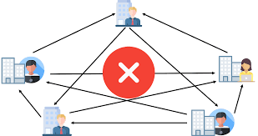
Why version control?
Quality. Teams can review, comment, and improve each other's code and assets.
Acceleration. Branch code, make changes, and merge commits faster.
Visibility. Understand and spark team collaboration to foster greater release build and release patterns.

Slide 5
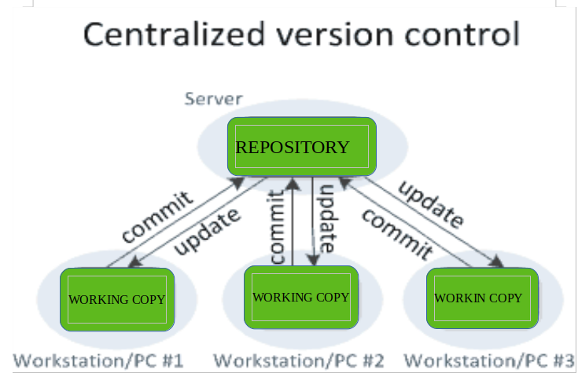

Slide 6
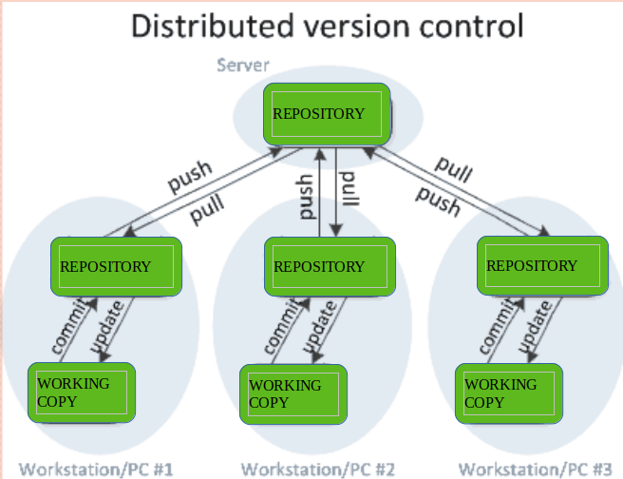

Slide 7
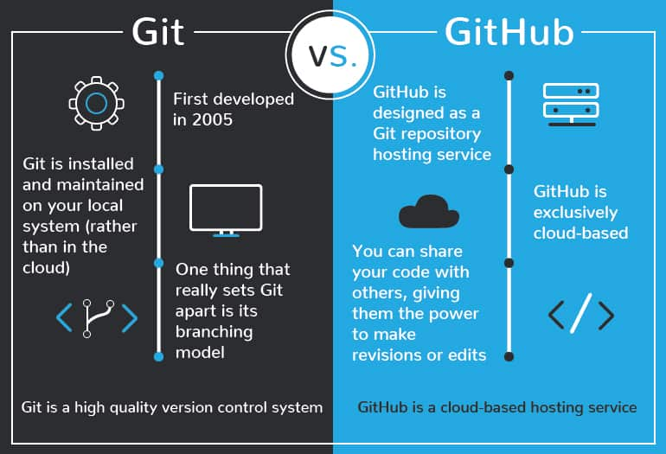
GIT & GIT-HUB

Slide 8
Introduce yourself to Git
Enter these lines (with appropriate changes):
  git config --global user.name "John Smith"
  git config --global user.email jsmith@seas.upenn.edu
You only need to do this once
If you want to use a different name/email address for a particular project, you can change it for just that project
  cd to the project directory
  Use the above commands, but leave out the --global

Slide 9
Commands
git pull remote_repository
  Get changes from a remote repository and merge them into your own repository
git status
  See what Git thinks is going on
  Use this frequently!
Work on your files
git add –-all (or just changes)
git commit –m “What I did”
git push

Slide 10
Commands
Command | Action
git init | used to create an empty Git repository.
git –version | To check version
git add | Add command is used after checking the status of the files, to add those files to the staging area.
git commit –m <message> | The commit command makes sure that the changes are saved to the local repository.
git status | command tells the current state of the repository.
git pull remote repository | Get changes from a remote repository and merge them into your own repository
git branch <branch_name> | To Create a branch
Git push | is used to transfer the commits or pushing the content from the local repository to the remote repository.

Slide 11
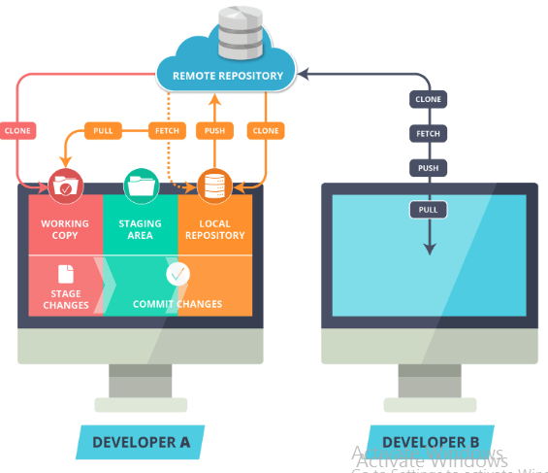
GIT HUB WORK FLOW

Slide 12
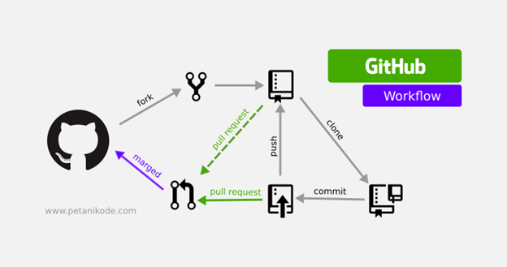
TYPICAL WORKFLOW

Slide 13
Viewing and Resetting repository
See what is on the repository
  git remote
  ls to see files
  cd & cd .. to move around folders
  cat to see file contents
  vi to edit file contents and end with <esc> :wq
Get what is on repository
  git pull
  If it says to resolve manually, just vi that file and see the head which is yours

Slide 14
Git log commands
git log
  --pretty=oneline --max-count=2 git log
  --pretty=oneline --since='5 minutes ago' git log
  --pretty=oneline --until='5 minutes ago' git log
  --pretty=oneline --author=<your name> git log
  --pretty=oneline –all

Slide 15
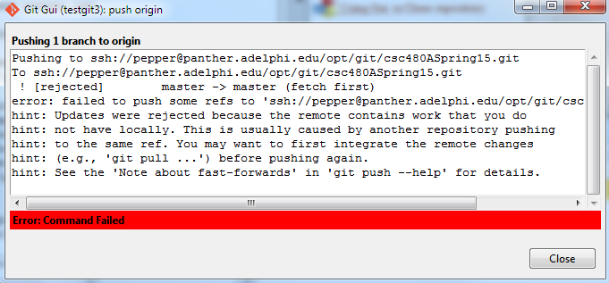
Failed Push
When you don't have the latest copy it will fail:

Slide 16
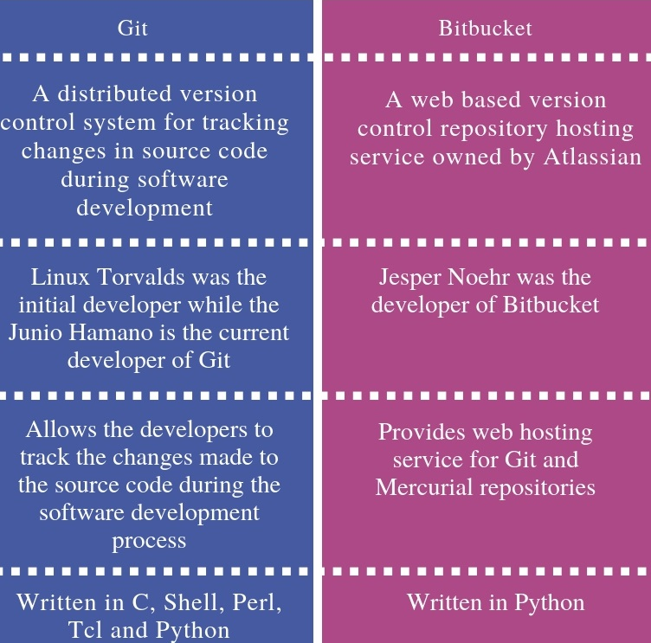
GIT vs BIT BUCKET

Slide 17
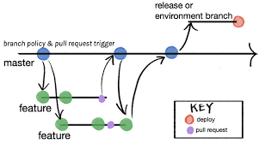
Branching stratergy

Slide 18

WHAT IS WEBHOOK
Webhooks are automated messages sent from apps when something happens. They have a message—or payload—and are sent to a unique URL—essentially the app's phone number or address. Webhooks are almost always faster than polling, and require less work on your end. They're much like SMS notifications.

Slide 19
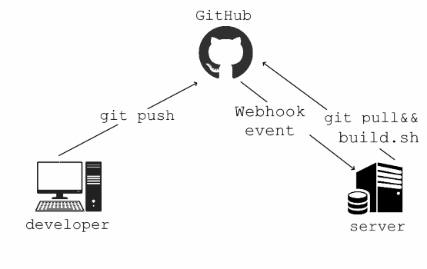
WEB HOOK

Slide 20
